Slide 1
PHASE 1 PROJECT

Slide 2
Introduction
Microsoft wants to venture into the film creation industry and we have access to data in different databases and dataframes to help Microsoft come up with a strategy to us in the new venture.

Slide 3
Objectives
To identify the most popular journals to put Microsoft on the movie creation radar.
To make projections on what genres can generate the most revenue for Microsoft
To evaluate what studios Microsoft could use for a higher revenue.
To establish the studios that Microsoft can collaborate with for high quality films, or see who their greatest competitors would be.

Slide 4
Data cleaning
The first step is checking and cleaning the data.
Data is cleaned by checking for any missing values and duplicates.
After finding the missing values, the next decision to make is whether to remove, replace and keep the null values.
The decision is made based on what data is required, and how the action taken impact all the data.

Slide 5
Data Analysis and Visualization
The next step is for analyzing the data to get outcomes and results, and to help plot graphs.
Joining tables helps in creating connections and comparisons between different datasets and dataframes.
Sometimes comparisons are made by picking out columns or rows for a better analysis.
There are several comparisons and connections used to make bar graphs for better visualization of the data.
Below are some of the plots derived from the analysis:

Slide 6
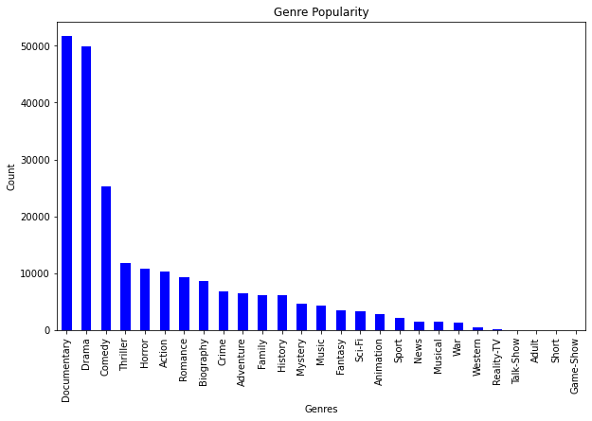
A bar graph showing the cumulative genre popularity

Slide 7
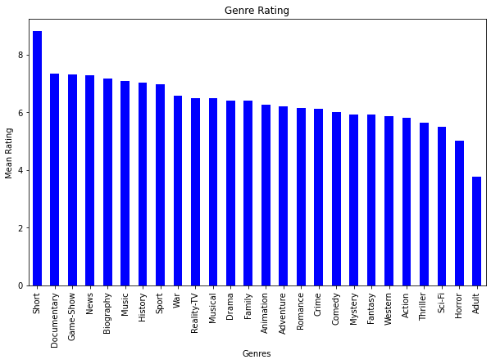
A bar graph showing the cumulative mean genre rating

Slide 8
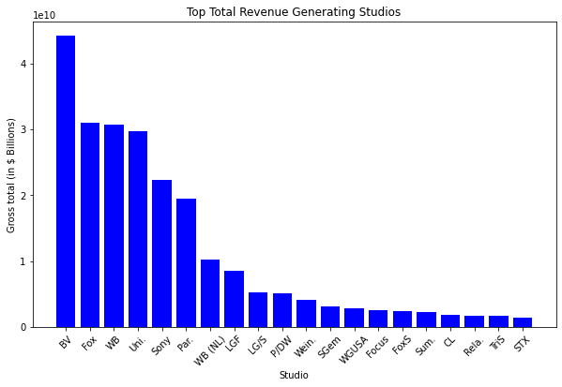
A bar Showing Studios with the Highest Gross Revenue

